Slide 1
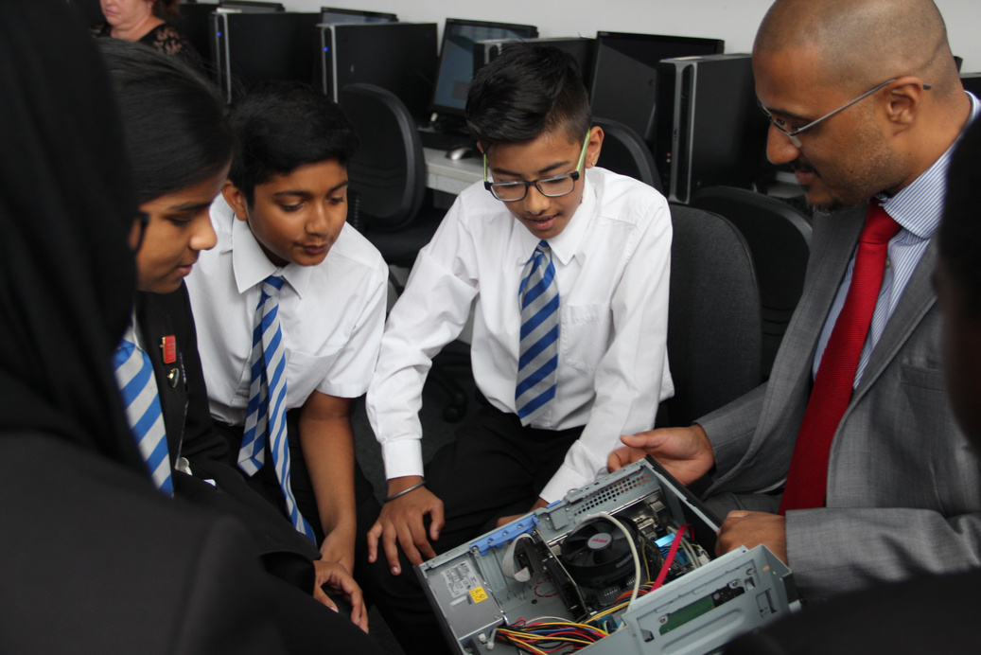
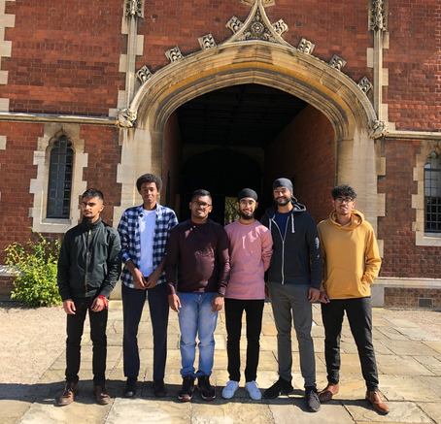
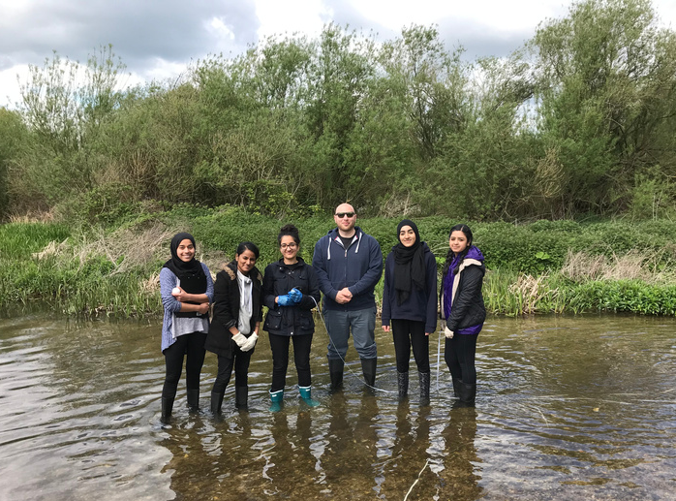
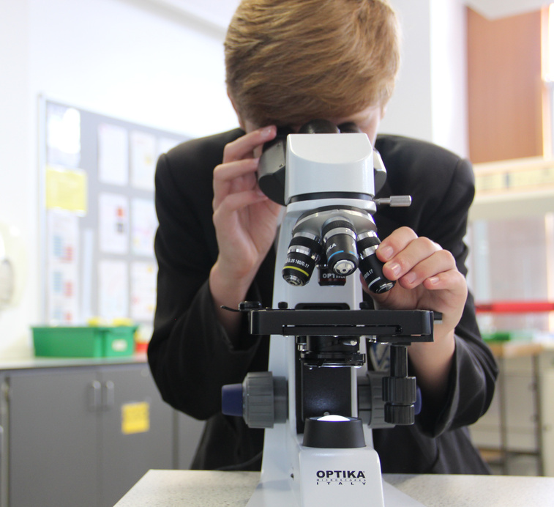
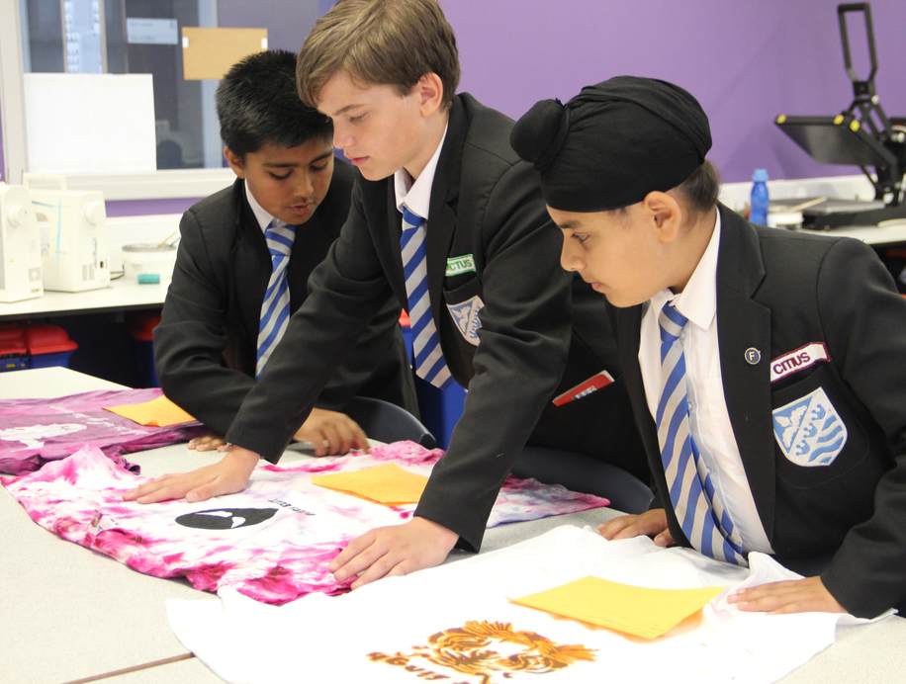
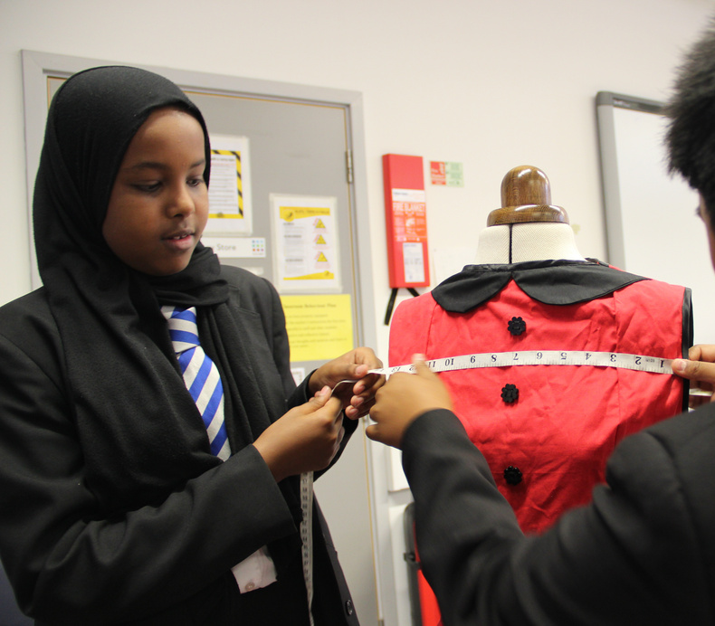
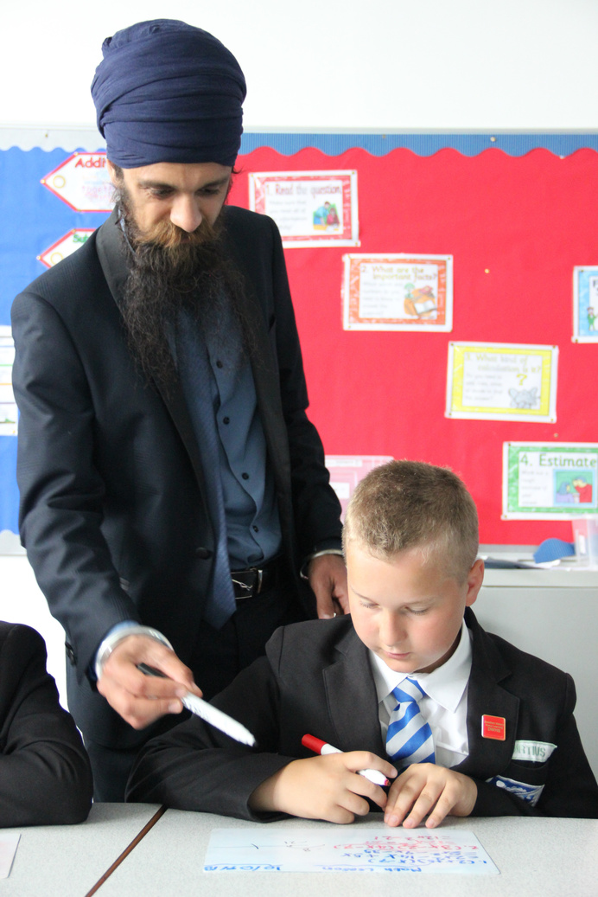
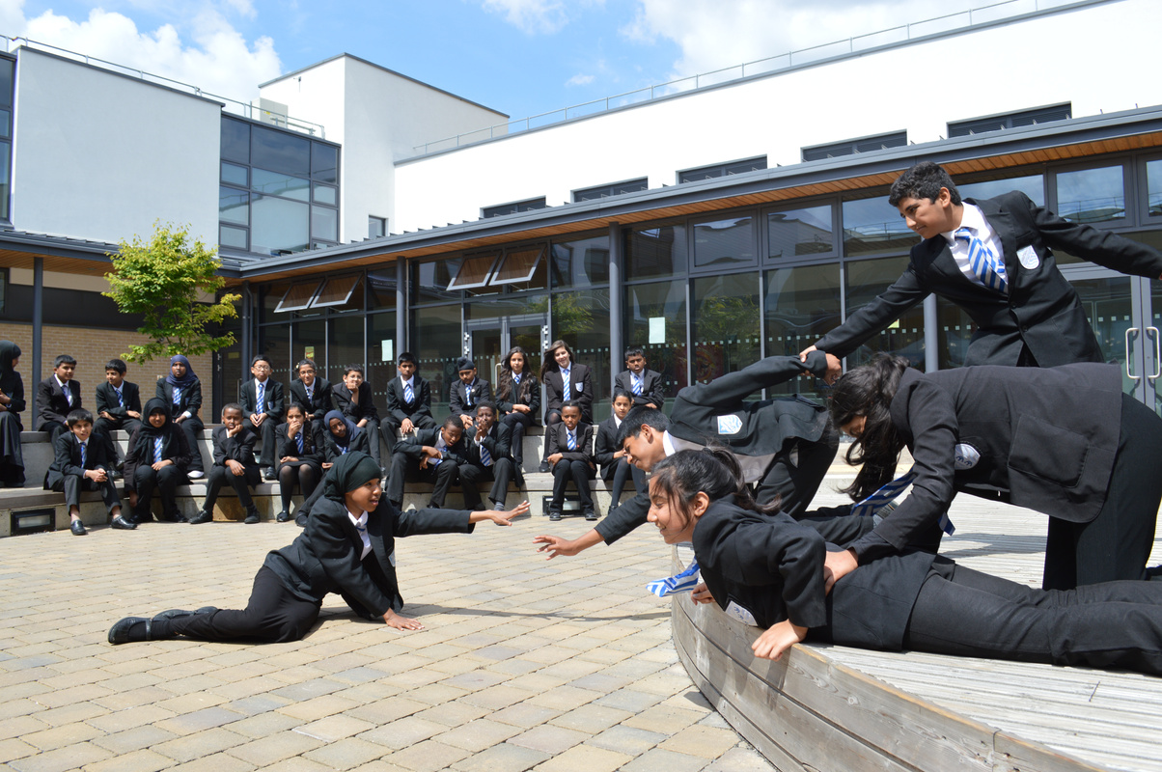
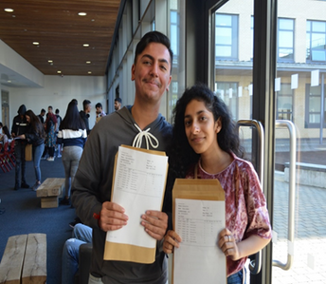
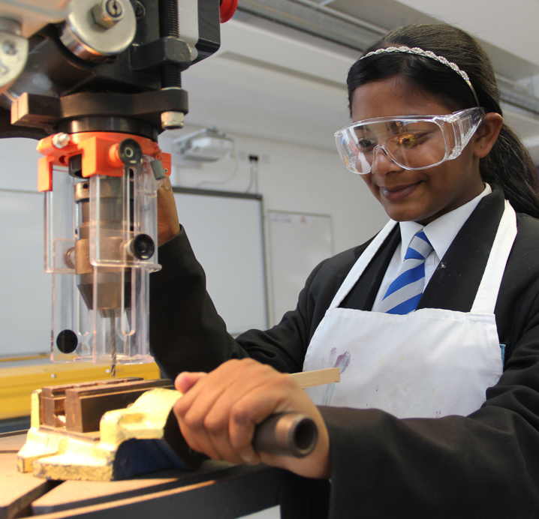
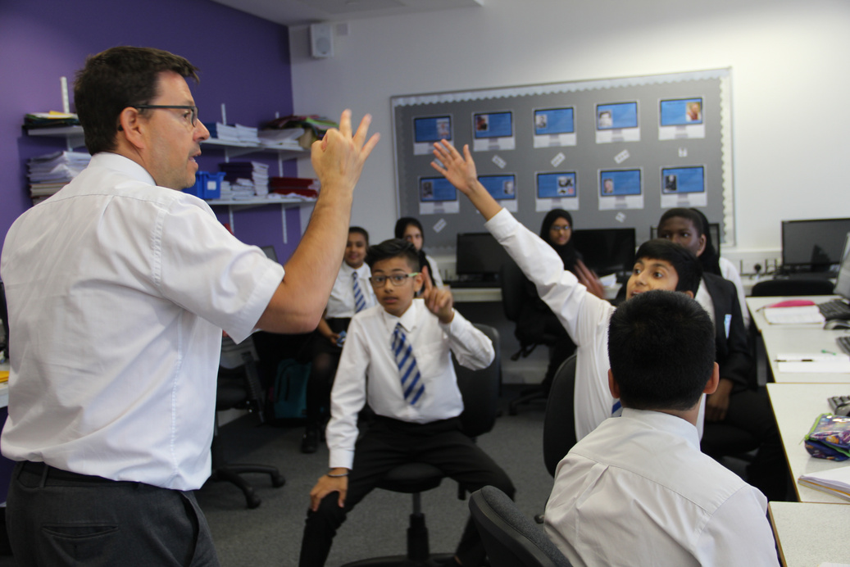
YEAR 8
OPTIONS EVENING

Slide 2
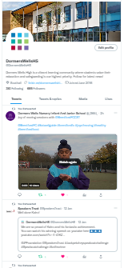
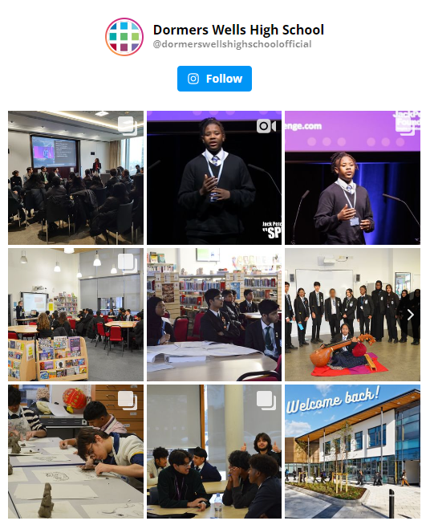
WELCOME TO YEAR 8 OPTIONS EVENING
Headteacher - Ms Walsh
​​ www.dwhs.co.uk ​
@DormersWellsHS
@CareersDWHS1 ​
@DormersWellsHigh SchoolOfficial

Slide 3
AIM
To support your child in making informed choices for Year 9.​
To provide you with further information on how best to support your child through the options process and selecting their subjects for Year 9.​

Slide 4
YEAR 9 OPTIONS
Options are a key milestone in each child's education.
Students will take some control over what they study.​​
Students are starting to plan seriously towards future careers, Sixth Form, University and so forth.​

Slide 5
CURRICULUM TIME
Subject | Hours Per Fortnight
English | 8
Maths | 8
Science | 8
Religious Education | 1
Computing | 1
Physical Education | 3
CPSHE | 1
French/Spanish | 4
Geography | 4
History | 4
Option A | 4
Option B | 4

Slide 6
CHOOSING YOUR SUBJECTS
POSITIVE
I’m good at the subject​
I enjoy the lessons​
I know what it will involve in the future​
It will help me when I’m older​

Slide 7
CHOOSING YOUR SUBJECTS
NEGATIVE
My friend is choosing the subject​
I like the teacher who is teaching me now​
It’s a new subject so I think that I’ll like it​
Other people want me to do the subject​

Slide 8
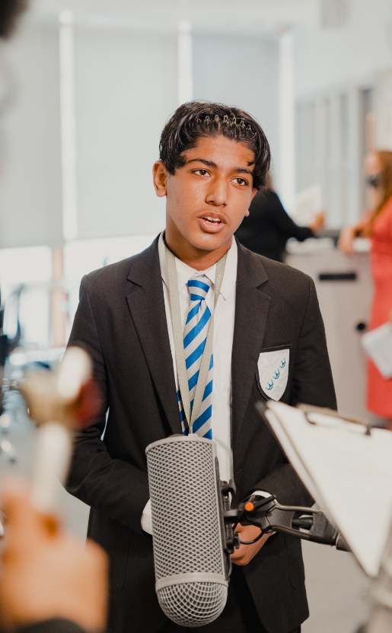
EBACC QUALIFICATIONS​
English
Mathematics
Science
Geography or History
French or Spanish​​
Most students will be expected to continue with a language and humanities subject in Y9 and 10.​

Slide 9
YEAR 8 INTO 9 OPTION FORM

Slide 10
YEAR 8 INTO 9 OPTION FORM

Slide 11
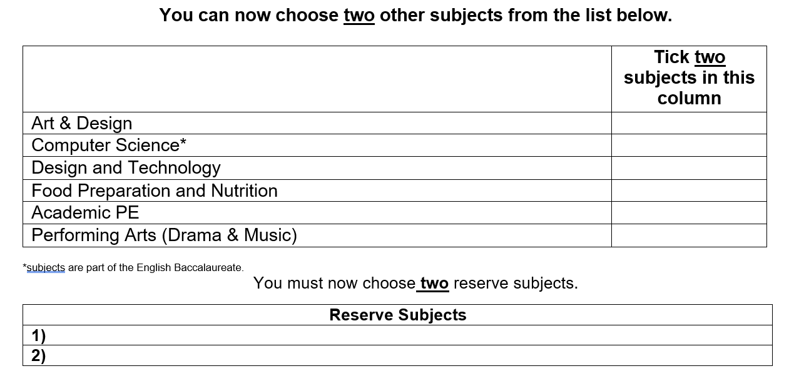
YEAR 8 INTO 9 OPTION FORM
If a subject is not selected at this stage for Year 9, it cannot be taken up for Year 10.

Slide 12
OPTIONS PROCESS
Sessions in form discussing careers and education choices
Options evening to meet curriculum areas
You must submit your final choices by handing your options form to your form tutor by Friday 23rd February.
Subjects are put into options blocks
​​A further meeting is arranged with any student who do not have all their first choices to provide further support in selecting a suitable course.​​
Students/parents are informed of the final choices

Slide 13
THANK YOU

